Slide 1
Minnesota Pedestrian Plaza
Mission of the DBBA:
To increase the vitality of the Downtown Bend by enhancing the experience, image and lifestyle of Downtown Bend Economic Improvement District.

Slide 2
Began working with SZABO
Share information with Stakeholders
Heard from the customers
& community leaders
Discuss with City Council
Launch Webpage
Created a committee
Identify Next Steps
Peer-city research
Timeline

Slide 3
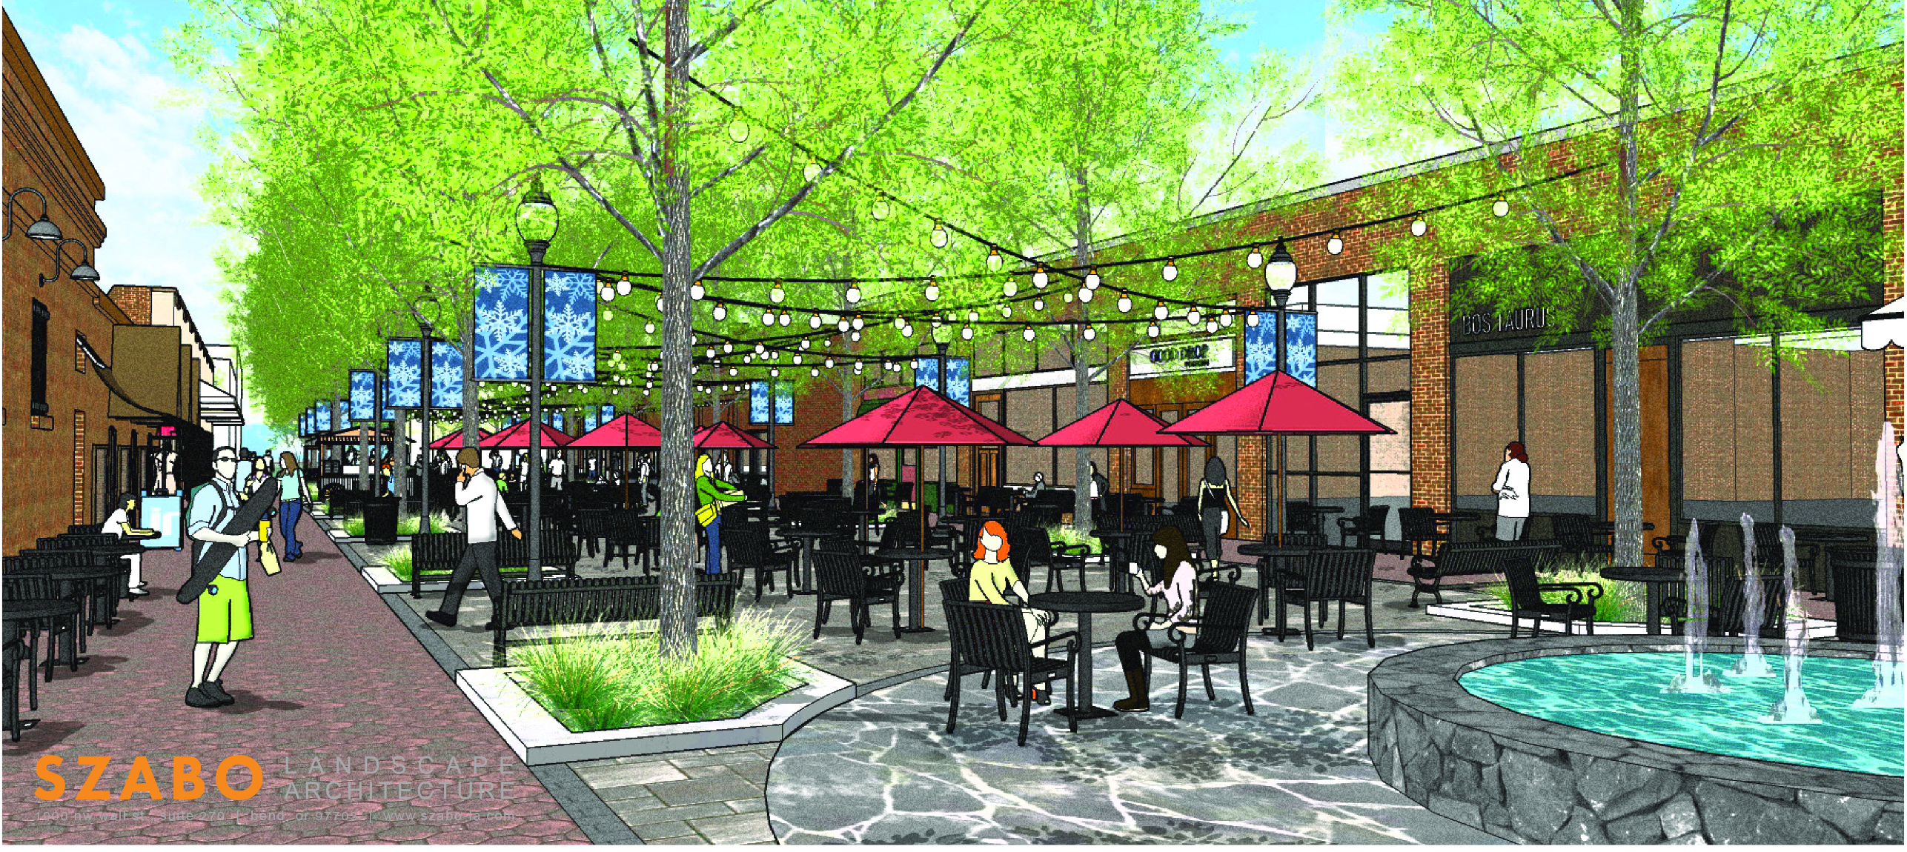

Slide 4
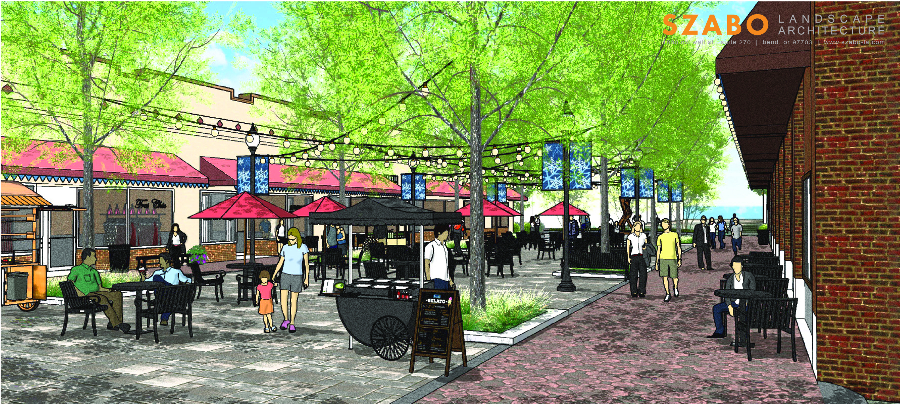

Slide 5
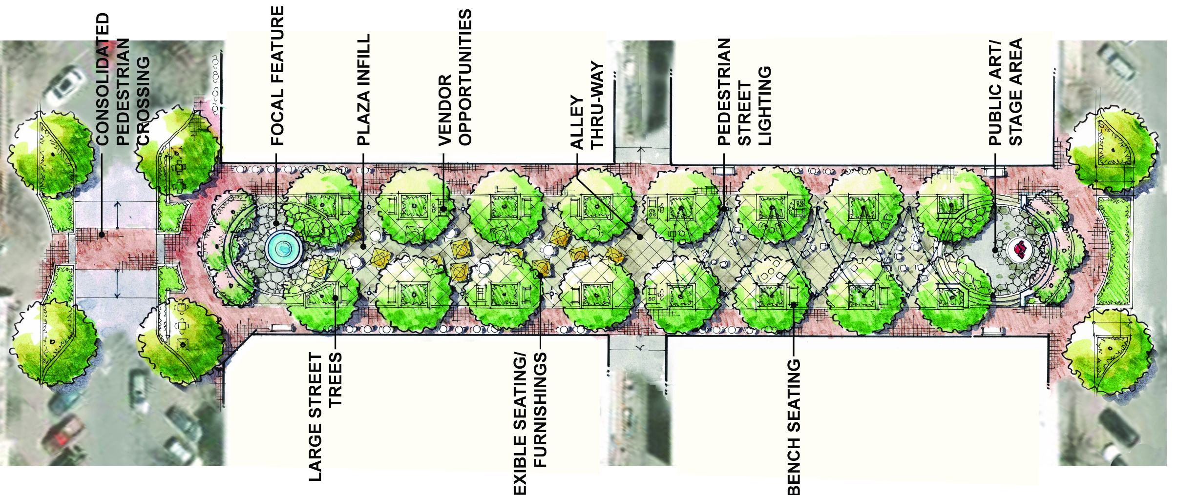
Wall Street
Bond Street

Slide 6
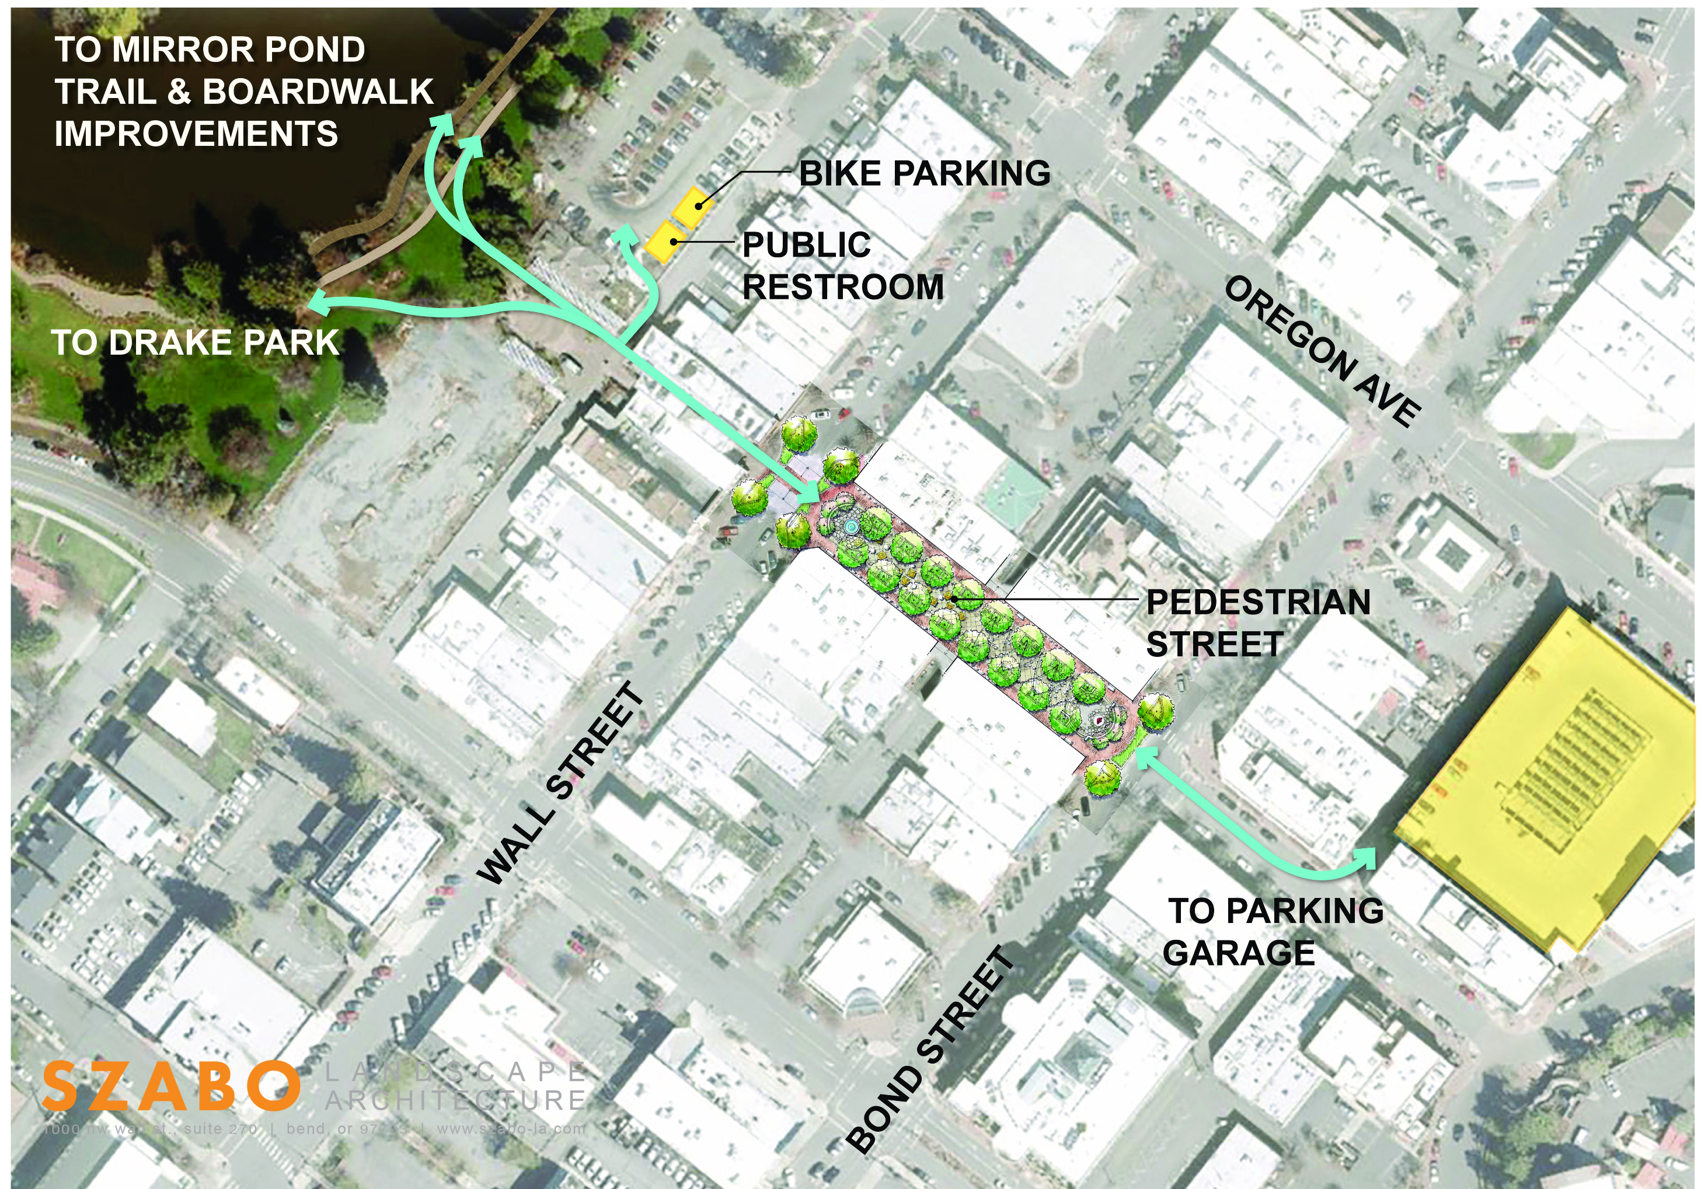

Slide 7
Pearl Street in Boulder, Colorado, 1976
Church Street in Burlington, Vermont, 1980
Lancaster Blvd, Lancaster, California, 2009
Gas Lamp Promenade, San Diego, CA, in development
Downtown Fort Collins, Colorado, 2015
Third Street Promenade, Santa Monica,CA, 1989
In addition to extensive online research, we personally spoke to peer-cities with successful promenades

Slide 8
Here is what we learned
Must haves
R&D investment
Ongoing funding sources identified
Consistent Programming
Beautification
Consistent Cleaning & Stewardship
Accessibility (including parking)
Community buy-in
Opportunities
Positive Environmental Impacts
Increased property value
Expression of community values
Slows down movement in the core
Fuel Private Investment
Heightened awareness needed
89% of promenades fail *
Livability concerns can increase
Construction impact on businesses
Types of events/vendors
Gentrification

Slide 9
Identify Community Partners for large-scale (Minnesota) project
Expand COB’s vendor program to use more of this space
COB fund a comprehensive planning effort to develop an overall plan for Downtown Bend
Begin working on restrooms and bike parking facility
Reconvene at a future City Council meeting
~6 months after funding is approved
When TRT grants open Aug 2021
Fall/Winter 2021
Engage the community
& stakeholders in additional conversation
Waive or reduce COB’s fees to host non-vendor events on Minnesota to incentive the community to use this space
Identify Next Steps
Invite community to invest “sweat equity” into this space
Identify funding sources
Future Timeline

Slide 10
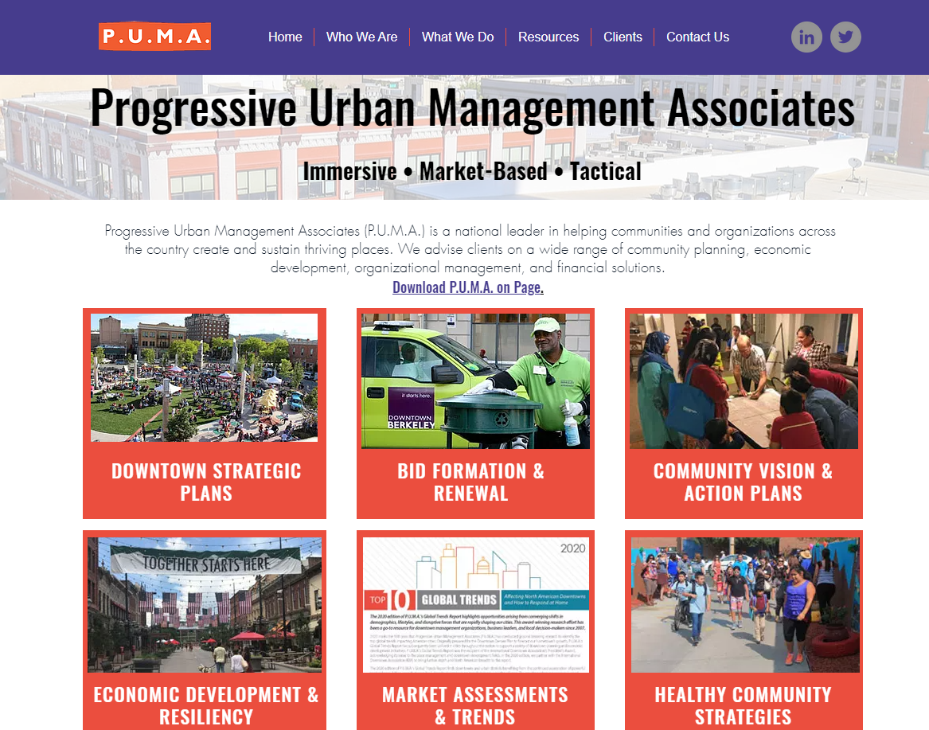

Slide 11
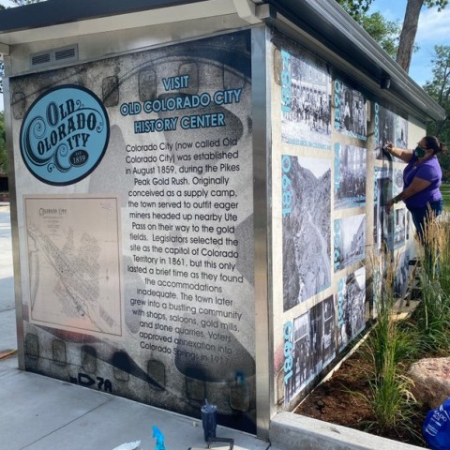
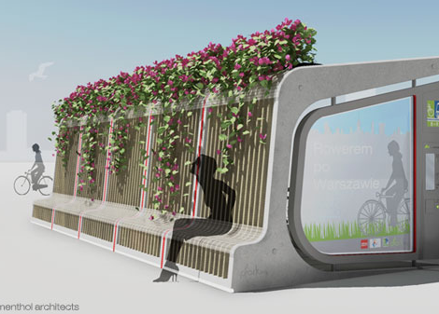
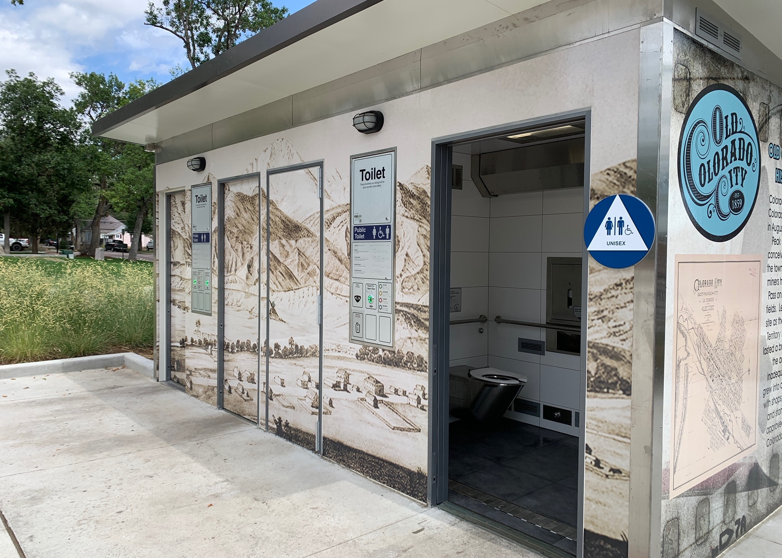

Slide 12
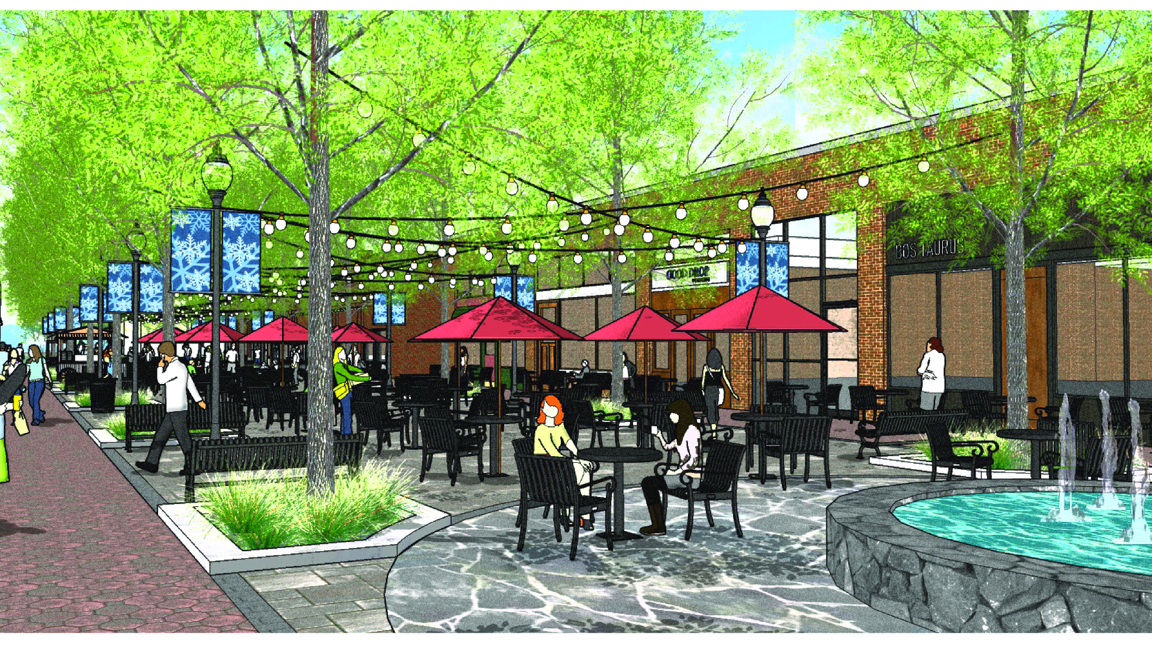
Questions?

